Slide 1
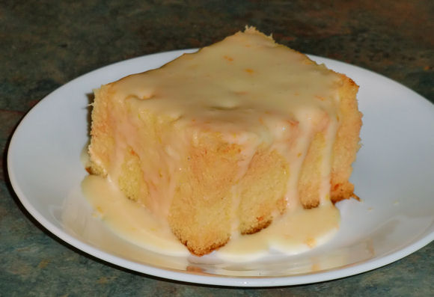
Yellow Cake Squares!
Ingredients
1 medium sweet potato, peeled and coarsely chopped OR ½ cup of pumpkin puree
3 large carrots, peeled & sliced into thick chunks- mix with2 tbsp of water
3 large eggs
1/3 cup of applesauce
1 cup water
½ cup oat bran
1 box yellow cake mix
Optional Glaze: 1 ¼ cup of confectionary sugar & 3 tbsp milk (mix well)
Directions:
Pre-heat oven to 350 degrees and spray a cake pan with oil, then lightly dust with flour.
Make orange puree: Place sweet potato & carrots in a medium pot & cover with cold water. Bring to a boil and cook for about 20 minutes, until carrots are tender. Be sure they are soft and tender! Drain and put them in food processor with 2 tbsp of water. Puree on high and smooth until no pieces are showing. This recipe makes 2 cups- you will NOT use it all, store in your refrigerator- it’ll last 3 days.
In the bowl of an electric mixer, combine eggs, carrots/sweet potato puree, applesauce, water, oat bran, and cake mix.
Blend at low speed for 30 seconds, then increase speed to medium for another 2 minutes.
Pour batter into cake pan or muffin tins.
6. Bake cake for 33 to 36 minutes, cupcakes for 18 to 21 minutes, both until a toothpick inserted in the center comes out clean.

